Slide 1
TRANSPARENT CHARITY APPLICATION USING BLOCKCHAIN
ALEENA PAUL
S4 mca a

Slide 2
RELEVANCE
Nowadays, people are becoming voracious to contribute to society. Many people want to donate generously for the causes they believe in but usually end up doing nothing due to no trust in the system around them. There are a lot of charitable organizations and NGOs that require funds now and then, which are working for the betterment of society.
We need a system that can decrease this fraud. Thus a new system is proposed to overcome this challenge.

Slide 3
DESCRIPTION
There are four types of users such as government, NGO, retailer, and users. Users can donate some amount to the NGO and retailer. Government can see donations for the proposal. This system will make the entire process more transparent.
We are using blockchain for a charity donation to make it more transparent. This Application provides trust between the users and donors. This helps resolve the trust issues, as people already know what they are pay.

Slide 4
OBJECTIVES
To to provide privacy, security, and transparency for a charity application.
To invest the public’s trust in government organizations or agencies.The lack of transparency in government activities could be solved technically with this blockchain charity system, which could increase the public's trust in these organizations.

Slide 5
EXISTING SYSTEM
In existing charity applications everything is done manually, so it is very difficult to maintain the records. It’s also very difficult to find the activities. It is a Long-time process. It takes more time to prepare various events within a short time.
The biggest disadvantage of most NGOs there are exceptions is that they are not able to scale up their success. NGOs have many workers, and the effort they put in is considerable. But, when they succeed, it is often in a limited area. And, they cannot easily scale up.

Slide 6
PROPOSED SYSTEM
The proposed system uses blockchain technology for a charity donation to make it more transparent.
For those making a charitable donation, blockchain provides the ability to precisely track where your donation is going when they arrive and whose hands they ended up in.

Slide 7
MODULES
This system consists of four types of users such as government, NGO, retailer, and users.
NGO: NGOs can add their work and view their proposal.
Contractor/Retailer: These are the entities who pitch their senders and quote the price. The Contractor with the most optimal solution with lowest price selected by the government official.
User (Donor):- They are the entities who will view the requirements published by various NGO and the accepted tenders choose to donate as per the capabilities and reference to the cause.
Government Official:- The Government can see donations for the proposal. The government can approve the lowest proposal. The government can see all users. They can manage retailers and ngos. Approve and decline their proposal

Slide 8
METHODOLOGY
The user can donate some amount to the NGO and retailer. The Government can see donations for the proposal. The government can approve the lowest proposal. The government can see all users.
NGO users can see if work tender is allocated to which retailer. NGO users can add a new work requirement. Retailer users can submit a proposal of work and can see the proposal status. Retailer users can see donations received for proposals.

Slide 9
FRONT END AND BACKEND TOOLS
HTML : The HyperText Markup Language, or HTML is the standard markup language for documents designed to be displayed in a web browser. It can be assisted by technologies such as Cascading Style Sheets and scripting languages such as JavaScript.
CSS : Cascading Style Sheets is a style sheet language used for describing the presentation of a document written in a markup language such as HTML.
Python : Python is a computer programming language often used to build websites and software, automate tasks, and conduct data analysis.
Ganache : Ganache is used for setting up a personal Ethereum Blockchain for testing your Solidity contracts
Truffle : Truffle is a world-class development environment, testing framework and asset pipeline for blockchains using the Ethereum Virtual Machine (EVM)
Web 3 : Web3 is a new iteration of the world wide web that hosts decentralized apps that run on blockchain technology

Slide 10
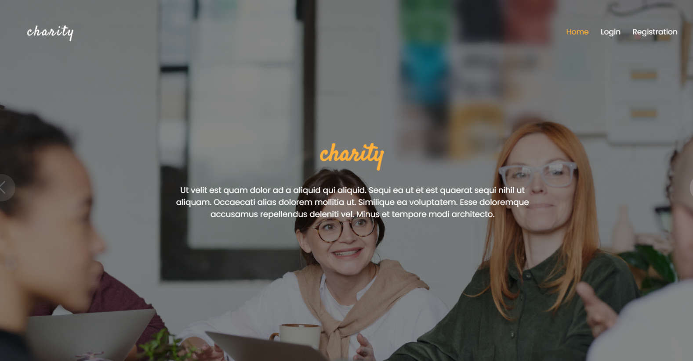
Screenshots

Slide 11
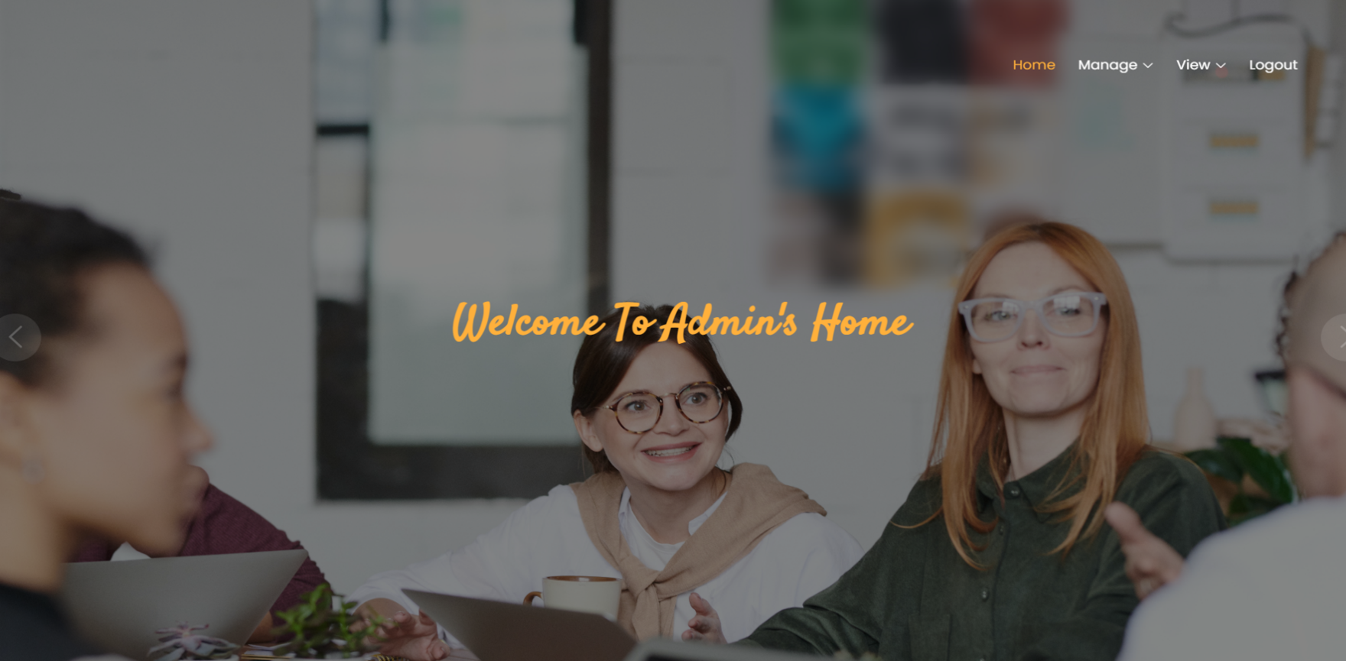
THANK YOU
THANK YOU

Slide 12


Slide 13
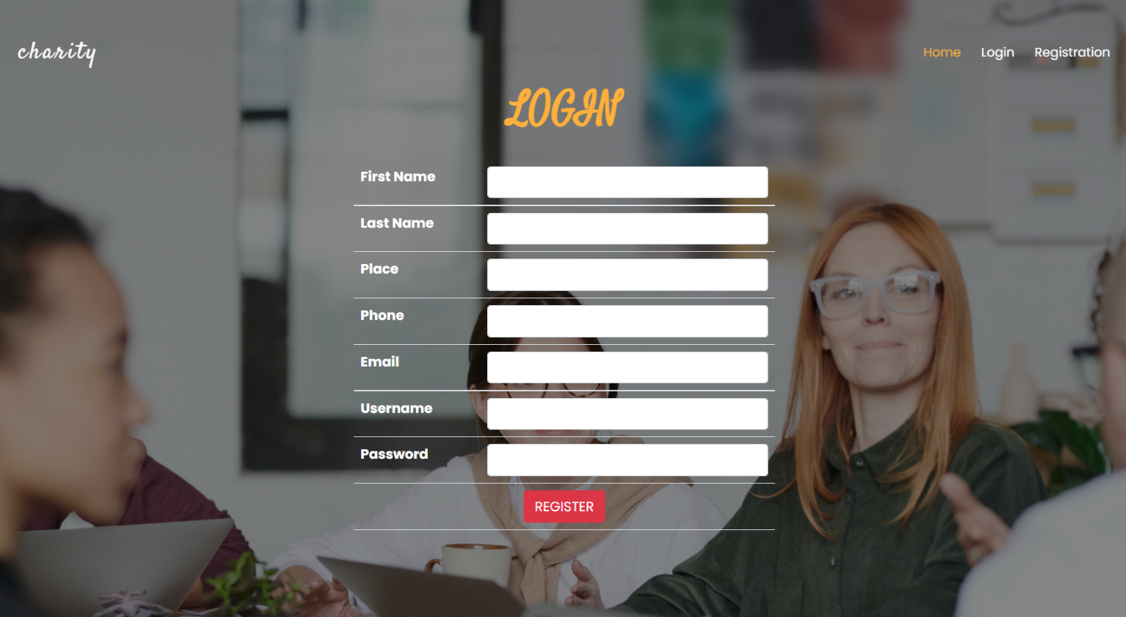

Slide 16
THANKYOU
THANK YOU

